Slide 1


Evaluation Metrics in Machine Learning
Welcome to this comprehensive overview of evaluation metrics in machine learning. Throughout this presentation, we'll explore the essential metrics used to assess both classification and regression models, providing you with the knowledge to effectively evaluate model performance.
We'll start by examining classification metrics like accuracy, logarithmic loss, and area under curve, then move on to regression metrics such as mean absolute error and R2 score. For each metric, we'll cover the formula, interpretation, and practical applications.

Slide 2
Understanding Model Evaluation
Evaluating machine learning models is a critical step in the development process. Without proper evaluation, we cannot determine if our model is performing as expected or compare different models effectively.
The choice of evaluation metric depends on the type of problem. Classification problems use metrics like accuracy and F1 score, while regression problems use metrics like mean absolute error and R2 score.
Throughout this presentation, we'll explore these metrics in detail, understanding their mathematical foundations, practical applications, and limitations. This knowledge will help you select the right metric for your specific machine learning task.

Slide 3





Classification Metrics Overview
Classification Accuracy
Ratio of correct predictions to total predictions
Logarithmic Loss
Penalizes false classifications using probability values
Area Under Curve
Plots True Positive Rate vs False Positive Rate
F1 Score
Harmonic mean of precision and recall
Confusion Matrix
Table showing prediction outcomes versus actual values

Slide 4
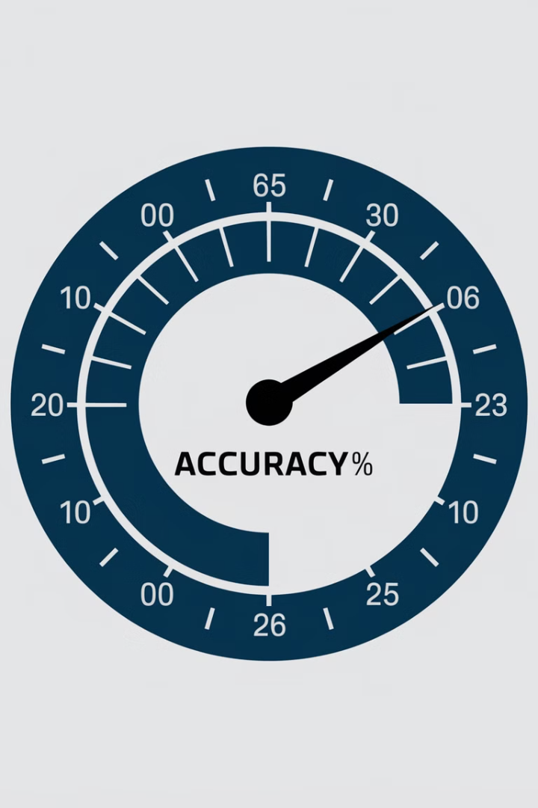
Classification Accuracy
Definition
Formula
Classification accuracy is a fundamental metric that provides a quick snapshot of model performance. It's calculated as the ratio of correct predictions to the total number of input samples.
Accuracy = (Number of correct predictions) / (Total number of input samples)
Limitations
Works well with balanced classes but can be misleading with imbalanced data. A model predicting the majority class for all samples can achieve high accuracy while being practically useless.

Slide 5

Accuracy: Practical Example
1
Dataset Composition
2
Test Set Performance
Consider a dataset with 90% samples of Class A and 10% samples of Class B. A model always predicting Class A would achieve 90% accuracy on this training set.
If we test the same model with a test set containing 60% Class A and 40% Class B samples, accuracy would drop to just 60%.
3
False Sense of Performance
This example shows how accuracy can give a false positive sense of achievement. The problem arises when there's a high possibility of misclassifying minority class samples.

Slide 6




Logarithmic Loss (Log Loss)
Definition
Log loss works by penalizing false classifications, particularly effective for multi-class problems. It evaluates how close a prediction probability is to the actual class label.
Formula
LogarithmicLoss = (-1/N) × ∑(i=1 to N) ∑(j=1 to M) yᵢⱼ × log(pᵢⱼ)
1
2
Application
Interpretation
The classifier must assign a probability to each class for all samples. This makes it ideal for problems requiring probability outputs rather than just class labels.
4
3
Range is [0,∞) with values closer to 0 indicating higher accuracy. Minimizing log loss generally improves classifier performance.

Slide 7




Understanding Log Loss Terms
Probability Assignment
Actual Class Indicator
Minimization Goal
pᵢⱼ represents the probability assigned by the model that sample i belongs to class j. Better probability estimates lead to lower log loss.
yᵢⱼ indicates whether sample i belongs to class j (1 if true, 0 if false). This binary value acts as a filter in the loss calculation.
The primary objective is to minimize log loss. As log loss approaches zero, the model's predicted probabilities more closely match the actual distribution of classes.

Slide 8

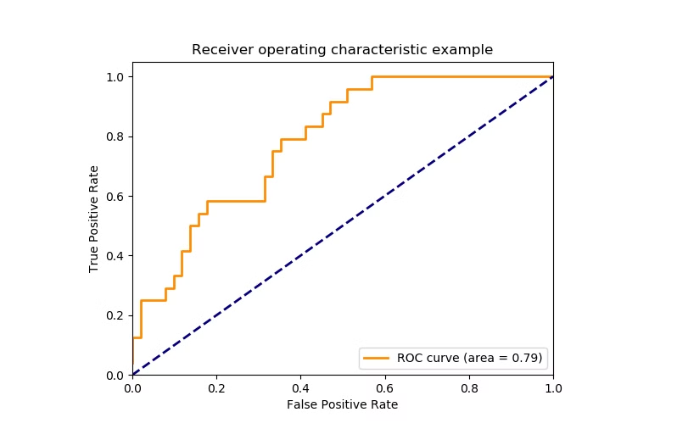
Area Under Curve (AUC)
1
Definition
AUC is widely used for binary classification. It represents the probability that a classifier will rank a randomly chosen positive example higher than a randomly chosen negative example.
2
ROC Curve
AUC is calculated from the Receiver Operating Characteristic (ROC) curve, which plots True Positive Rate versus False Positive Rate at different classification thresholds.
3
Interpretation
Values range from 0 to 1, with higher values indicating better model performance. A value of 0.5 suggests no discriminative ability (equivalent to random guessing).
4
Advantage
AUC is insensitive to class imbalance, making it particularly useful when working with datasets where one class is much more frequent than the other.

Slide 9

Understanding TPR and FPR
TPR
TNR
True Positive Rate
True Negative Rate
Also called sensitivity, TPR is the proportion of actual positives correctly identified as such. Formula: TPR = TP / (TP + FN)
Also called specificity, TNR is the proportion of actual negatives correctly identified as such. Formula: TNR = TN / (TN + FP)
FPR
False Positive Rate
The proportion of actual negatives incorrectly classified as positives. Formula: FPR = FP / (FP + TN)

Slide 10




F1 Score: Balancing Precision and Recall
F1 Score
1
Harmonic mean of precision and recall
Precision
2
Positive predictive value
Recall
3
True positive rate
True/False Positives/Negatives
4
Basic classification outcomes
The F1 score provides a single metric that balances precision and recall. With a range of [0,1], higher F1 scores indicate better performance. It's particularly useful when you need to find an optimal balance between precision and recall, as it penalizes extreme values in either metric.

Slide 11
Precision: Accuracy of Positive Predictions
Definition
1
Proportion of correct positive identifications
Formula
2
Precision = TP / (TP + FP)
Application
3
Critical when false positives are costly
Precision measures how many of the positive predictions made by the model are actually correct. It's particularly important in scenarios where false positives carry a high cost, such as spam detection (where marking legitimate emails as spam is problematic) or medical diagnostics (where a false positive might lead to unnecessary treatments).
High precision indicates that when the model predicts the positive class, it is usually correct, though it doesn't tell us anything about the cases the model might have missed.

Slide 12

Recall: Capturing All Positive Cases
Application
Formula
Recall is critical in scenarios where missing positive cases is costly, such as disease detection or fraud identification. High recall ensures we minimize false negatives.
Definition
Recall = TP / (TP + FN)
Recall measures how many of the actual positive cases our model captured. It's the proportion of actual positives correctly identified by the model.

Slide 13
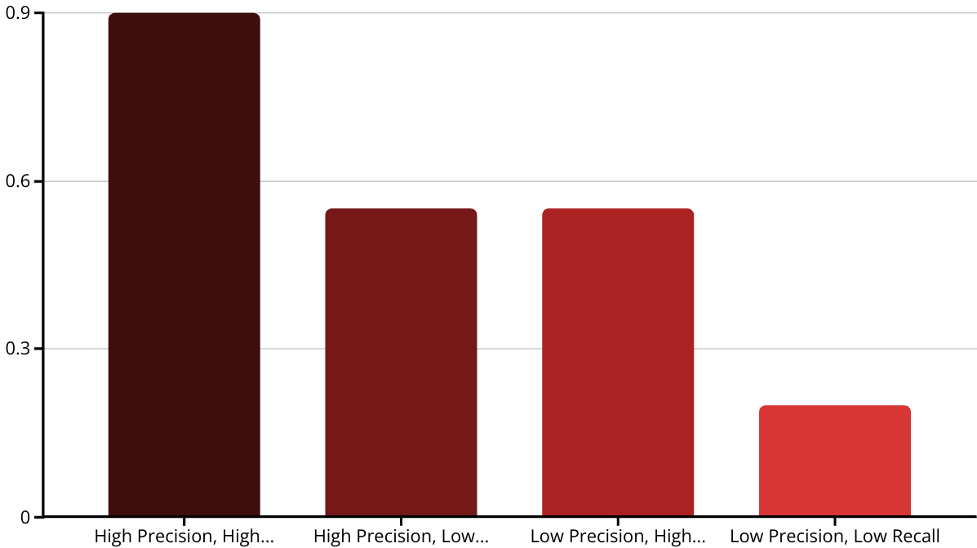
F1 Score: Mathematical Expression
The F1 score is expressed mathematically as: F1 = 2 × (1 / ((1/precision) + (1/recall)))
This formula shows that F1 score is the harmonic mean of precision and recall. The chart illustrates how different combinations of precision and recall affect the F1 score. Notice how the F1 score penalizes situations where either precision or recall is low, encouraging a balance between the two metrics.

Slide 14

Confusion Matrix
n=165
Predicted: NO
Predicted: YES
Actual: NO
50 (True Negative)
10 (False Positive)
Actual: YES
5 (False Negative)
100 (True Positive)
A confusion matrix creates an N×N matrix, where N is the number of classes to be predicted. In binary classification (N=2), we get a 2×2 matrix as shown above. The matrix displays the counts of true positives, true negatives, false positives, and false negatives.
The accuracy from this matrix is calculated by taking the average of values in the main diagonal: Accuracy = (True Positive + True Negative) / Total Sample = (100 + 50) / 165 = 0.91

Slide 15




Four Key Terms of Confusion Matrix
True Positives (TP)
True Negatives (TN)
Cases where we predicted Yes and the actual output was also Yes
1
2
Cases where we predicted No and the actual output was also No
False Negatives (FN)
4
False Positives (FP)
Cases where we predicted No but the actual output was Yes
3
Cases where we predicted Yes but the actual output was No
These four terms form the foundation of many evaluation metrics in classification. Understanding them is crucial for interpreting not just the confusion matrix, but also derived metrics like precision, recall, and F1 score.

Slide 16
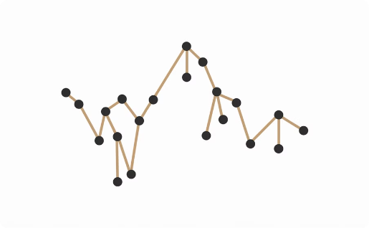


Regression Evaluation Metrics Overview
Mean Absolute Error (MAE)
Mean Squared Error (MSE)
Root Mean Square Error (RMSE)
Average of absolute differences between predicted and actual values, giving equal weight to all errors regardless of magnitude.
Average of squared differences between predicted and actual values, giving higher weight to larger errors.
Square root of MSE, bringing the units back to the same scale as the target variable for easier interpretation.

Slide 17
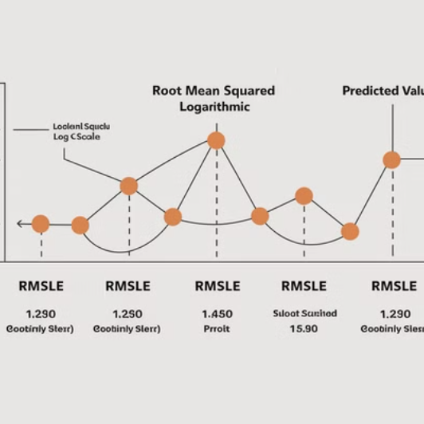


More Regression Metrics
Beyond MAE, MSE, and RMSE, there are additional important regression metrics. Root Mean Squared Logarithmic Error (RMSLE) is particularly useful when the target variable spans a wide range of values and we want to penalize underestimation more than overestimation.
The R² Score or coefficient of determination indicates the proportion of variance in the dependent variable that can be predicted from the independent variables. It ranges from 0 to 1, with higher values indicating better fit.

Slide 18

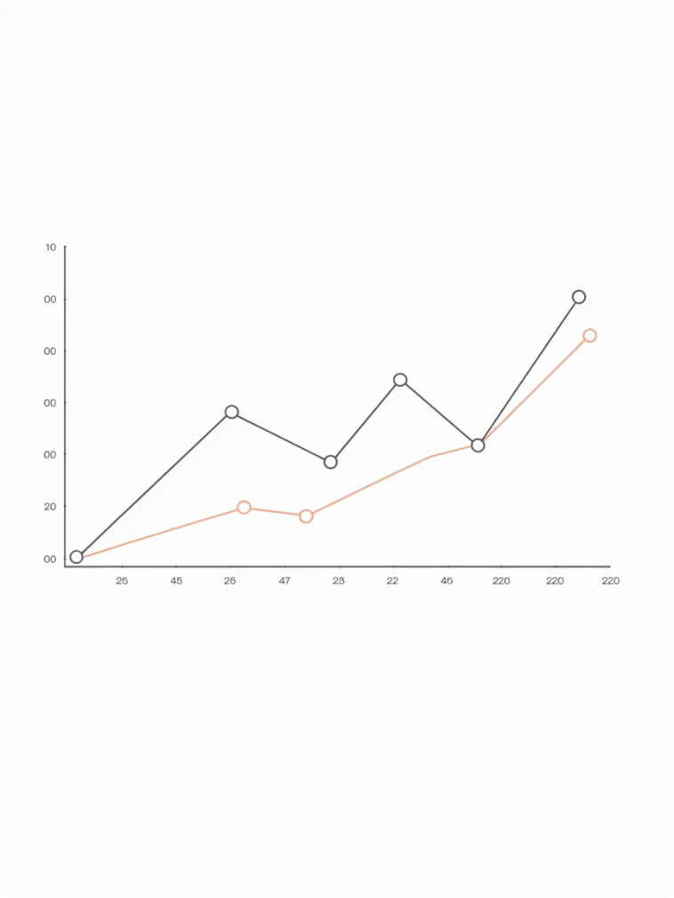
Mean Absolute Error (MAE)
Definition
Formula
MAE measures the average magnitude of errors in a set of predictions, without considering their direction. It's the average of absolute differences between predicted and actual values.
MAE = (1/N) × ∑|yⱼ - ŷⱼ|
Characteristics
MAE is robust to outliers and easy to interpret as it's in the same units as the target variable. However, it doesn't give any indication of error direction (under or over-prediction).

Slide 19

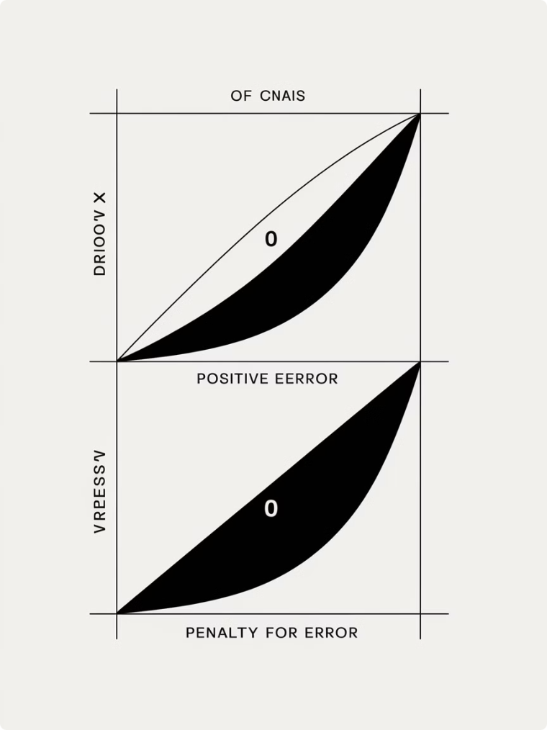
Mean Squared Error (MSE)
1
Definition and Formula
2
Advantages
The primary advantage of MSE is mathematical convenience - it's easier to calculate gradients compared to MAE, making it useful for optimization in many algorithms. By squaring errors, it gives more weight to larger errors.
MSE calculates the average of squared differences between predicted and actual values. Mathematically: MSE = (1/N) × ∑(yⱼ - ŷⱼ)²
3
Limitations
MSE is more sensitive to outliers than MAE. Additionally, the resulting value is in squared units, making direct interpretation less intuitive than metrics that preserve the original units.

Slide 20

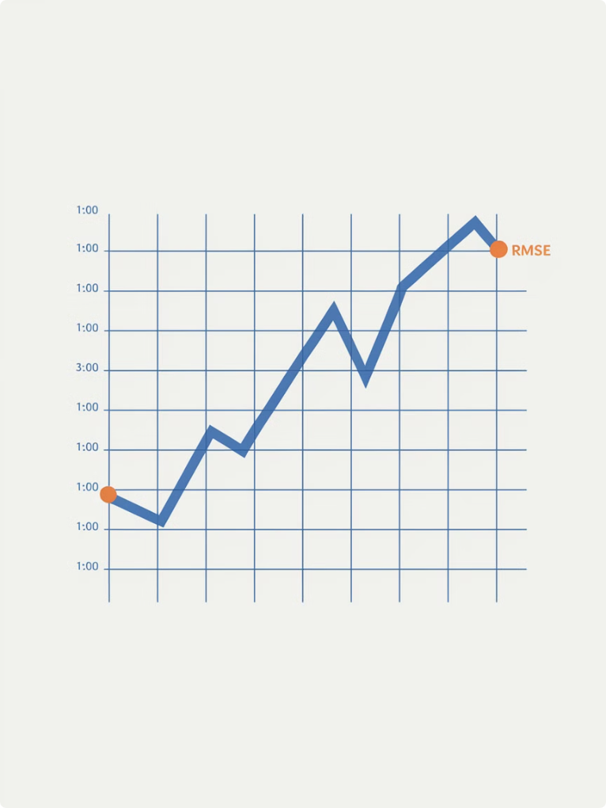
Root Mean Square Error (RMSE)
1
Definition
RMSE is obtained by taking the square root of the MSE value. This brings the metric back to the same units as the target variable, making it more interpretable.
2
Formula
RMSE = √[(∑(yⱼ - ŷⱼ)²)/N]
3
Characteristics
Like MSE, RMSE gives higher weight to large errors and is sensitive to outliers. However, it provides a value in the same units as the original data, making it easier to understand in context.
4
Use Cases
RMSE is widely used in meteorology, geology, and financial forecasting where accuracy is critical and larger errors should be penalized more heavily.

Slide 21
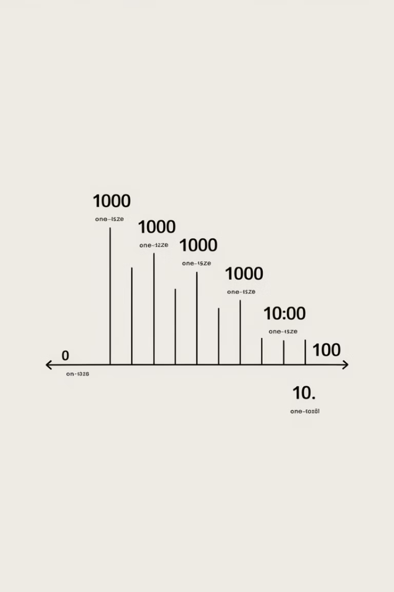




Root Mean Squared Logarithmic Error (RMSLE)
Definition
RMSLE applies a logarithmic transformation to both predicted and actual values before calculating RMSE. This makes it useful for cases where the target variable varies across a wide range of values.
Formula
RMSLE = √[(∑(log(ŷⱼ+1) - log(yⱼ+1))²)/N]
Key Benefits
RMSLE penalizes underestimation more heavily than overestimation, which is desirable in certain applications like sales forecasting where underestimating demand is typically more costly than overestimating.
Interpretation
Lower values indicate better fit, with 0 being perfect. The logarithmic transformation makes this metric less sensitive to large differences in the higher ranges of values.

Slide 22
R² Score (Coefficient of Determination)
Definition
Formula
Interpretation
The R² score, also known as the coefficient of determination, measures the proportion of variance in the dependent variable that is predictable from the independent variable(s). It indicates how well observed outcomes are replicated by the model.
While not explicitly given in the input, R² is typically calculated as 1 minus the ratio of the sum of squared residuals to the total sum of squares. Values range from 0 to 1, with 1 indicating perfect prediction.
An R² of 0.7 means that 70% of the variance in the dependent variable can be explained by the model. Higher values indicate better fit, though very high values can sometimes suggest overfitting.

Slide 23

Comparing Classification Metrics
1st
2nd
3rd
Accuracy
F1 Score
AUC-ROC
Best for balanced datasets with equal cost of false positives and false negatives. Simple and intuitive but can be misleading with imbalanced classes.
Ideal when seeking balance between precision and recall. Particularly useful for imbalanced datasets where both false positives and false negatives are concerns.
Excellent for ranking predictions and evaluating performance across various thresholds. Robust to class imbalance but may be less intuitive to interpret.

Slide 24
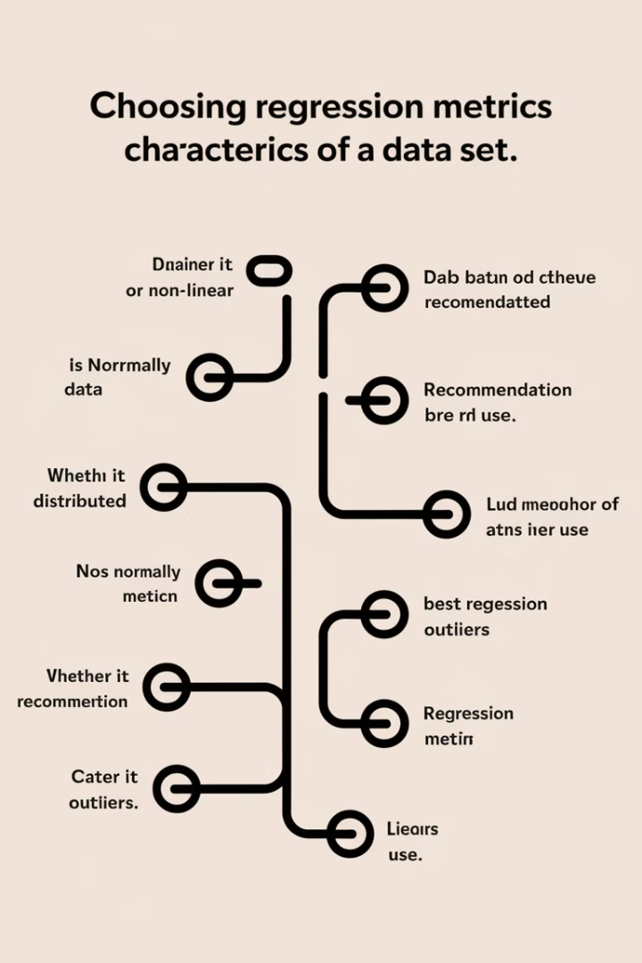



Comparing Regression Metrics
MAE
MSE/RMSE
R² Score
Use when errors should be treated equally regardless of direction. Less sensitive to outliers than squared error metrics. Provides error in the same units as the target variable.
Use when large errors are particularly undesirable. RMSE provides error in the same units as the target variable, making it more interpretable than MSE. Both are sensitive to outliers.
Use when you want to know how much of the variance is explained by your model. Standardized scale (0-1) makes it easy to interpret and compare across different models.

Slide 25




Summary: Choosing the Right Metric
Data Characteristics
Problem Type
Consider class balance (for classification) or value distribution (for regression). Imbalanced datasets may require metrics like F1 score or AUC rather than accuracy.
First determine if you're solving a classification or regression problem, as this dictates which family of metrics to consider.
1
2
Application Context
Error Tolerance
Consider the real-world implications of different types of errors. Some applications may be more sensitive to false positives, others to false negatives.
Determine if all errors should be treated equally (MAE) or if larger errors should be penalized more heavily (MSE/RMSE).
4
3

